Slide 1
Installation of Talend Data Catlog on linux server
Preparing your installation
# Files to download:-
1) The software package
2) The license file
#The link will show the compatible requirements to install TDC
https://help.talend.com/r/en-US/8.0/data-catalog-installation-and-upgrade-guide-windows/files-to-download

Slide 2
#Install compatible java version
cd /usr/lib
mkdir jvm
chmod -R 777 jvm
wget https://www.oracle.com/in/java/technologies/javase/jdk11-archive-downloads.html#license-lightbox
#extract the java file
tar -xvf jdk-11.0.17-linux-x64.tar.gz
#set the java path
cd /etc/profile.d
sudo vi jdk.sh
export JAVA_HOME=/usr/lib/jvm/jdk-11.0.18
export JRE_HOME=//usr/lib/jvm/jdk-11.0.18/jre (if jre is not in bin then remove the line)
export PATH=$JAVA_HOME/bin:$JRE_HOME/bin:$PATH

Slide 3
Installation of TDC
Software is available at https://www.opensourceetl.net/TalendDataCatalog
username: datacatalog
password: eu5bIR95mNZWmQHs6NCl
#goto latest version 8.0
#goto software packages
Installation of TDC-8-20230227.tbz2 file
cd /opt
mkdir TDC
cd /opt/TDC
#wget --user=datacatalog --ask-password http://www.opensourceetl.net/TalendDataCatalog/8.0/Software/TDC-8-20230227.tbz2
#sudo yum install bzip2
#tar xjvf TDC-8-20230223.tbz2

Slide 4
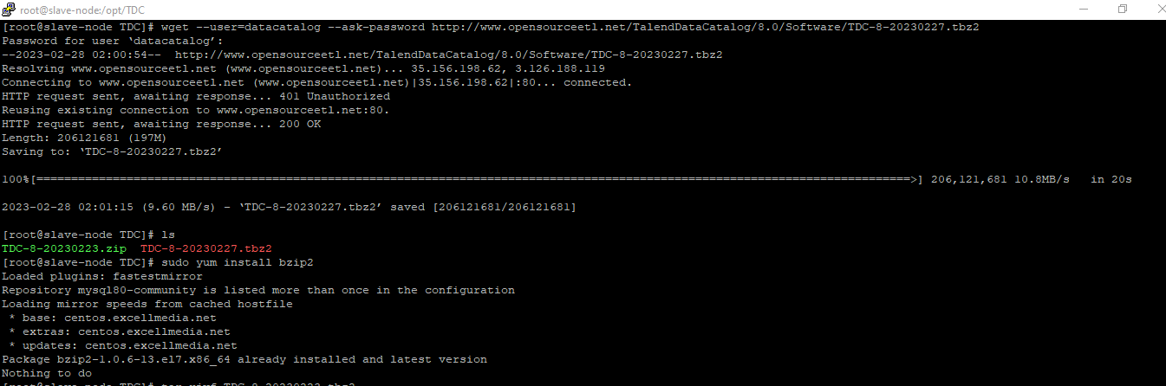

Slide 5
Cd /opt/TDC/TalendDataCatlog
# run the following command
./Setup.sh --tomcat-port 11480 --tomcat-service true --ssl false
11480 --tomcat-agent false
# Then Restart the TDC
./RestartServerApplication.sh

Slide 6
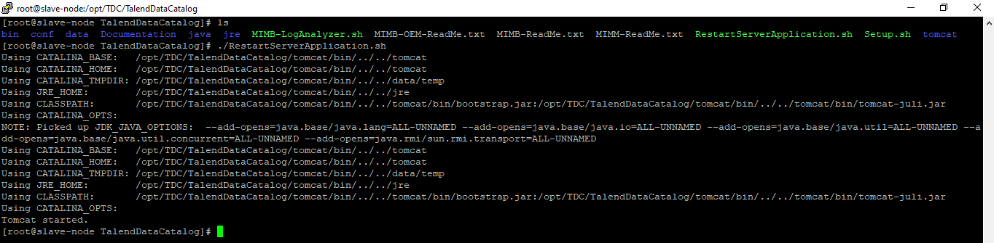

Slide 7
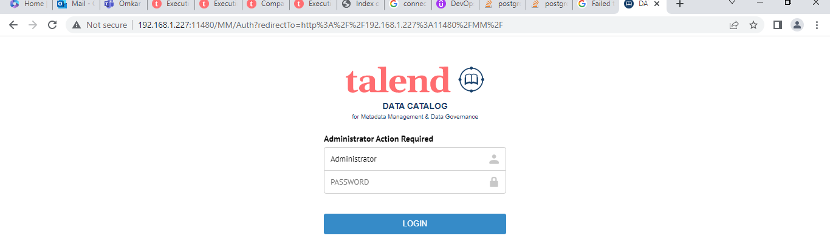
#Run the ip address and port on the browser
192.168.1.227:11480
Username :- Administrator
Password :- Administrator

Slide 8
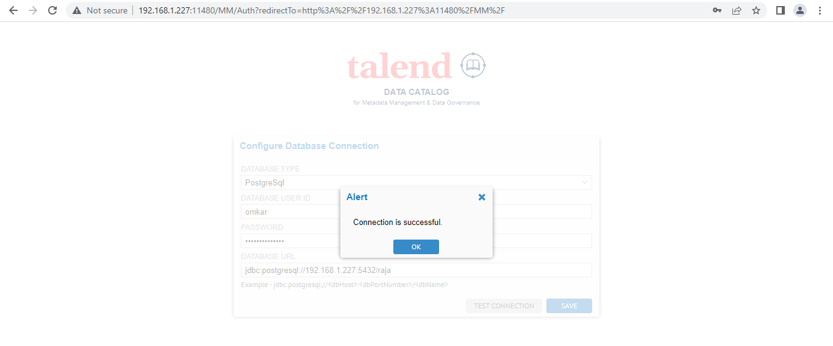
#configure all the database information and connect the database
Select the database type:-
Username:-
Password:-
jdbc:postgresql://<ip-address>:5432/<database-name>
#Test the connection and save it
#once again login by using username and password.

Slide 9
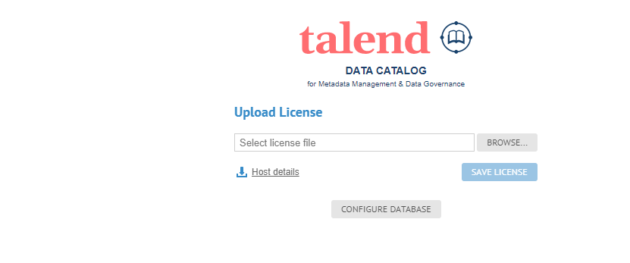
#upload a license file that you have
#Download the Host Details file
#Upload the Host details file in the URL provided with mail
It will generate the license
#Browse and Upload the license file and save it.

Slide 10
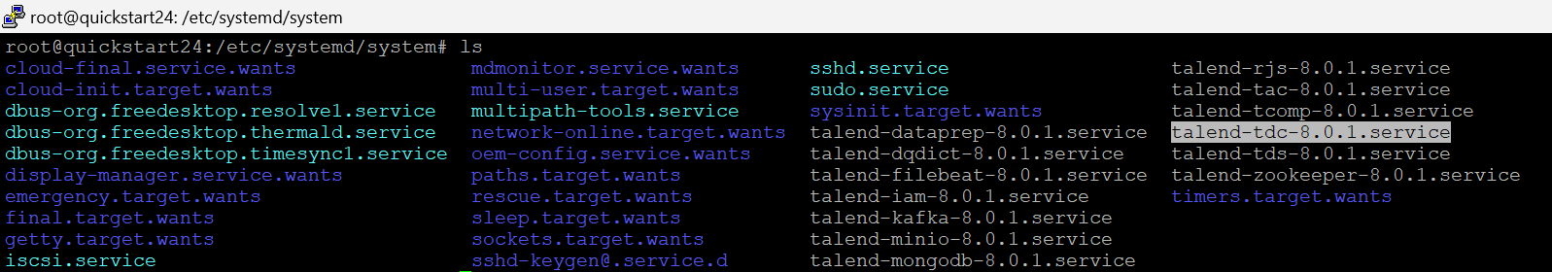
*Running The Talend data catalog service as a system service*
Note:- Initially after installation Talend data catalog service wont run as a system service we need to manually create a service file by adding parameters.
#Go to the system services folder.
cd /etc/systemd/system
vi talend-tdc-8.0.1.service

Slide 11
# systemd descriptor file for IAM service
[Unit]
Description=Talend Data catalog service
Before=runlevel3.target runlevel5.target
After=local-fs.target remote-fs.target network-online.target time-sync.target postgresql.target systemd-journald-dev-log.socket
Wants=network-online.target
Conflicts=shutdown.target
[Service]
Type=forking
Restart=no
TimeoutSec=5min
KillMode=process
Restart=no
PIDFile=/root/TDC/TalendDataCatalog/data/temp/catalina.pid #path of catalina process id
Environment=CATALINA_PID=/root/TDC/TalendDataCatalog/data/temp/catalina.pid
ExecStart=/root/TDC/TalendDataCatalog/RestartServerApplication.sh #path of service starting
ExecStop=/root/TDC/TalendDataCatalog/ShutdownServerApplication.sh #path of service stopping
User=root
Group=root
WorkingDirectory=/opt/TDP/iam
SuccessExitStatus=143 SIGKILL
[Install]
WantedBy=multi-user.target

Slide 12
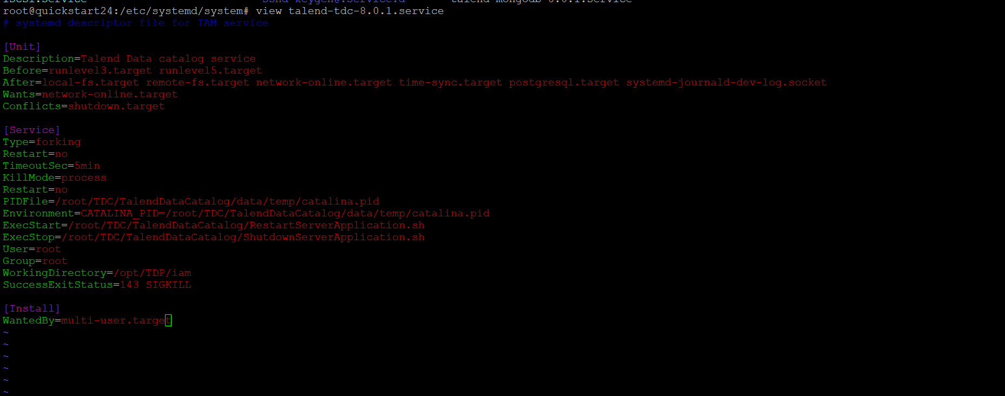

Slide 13
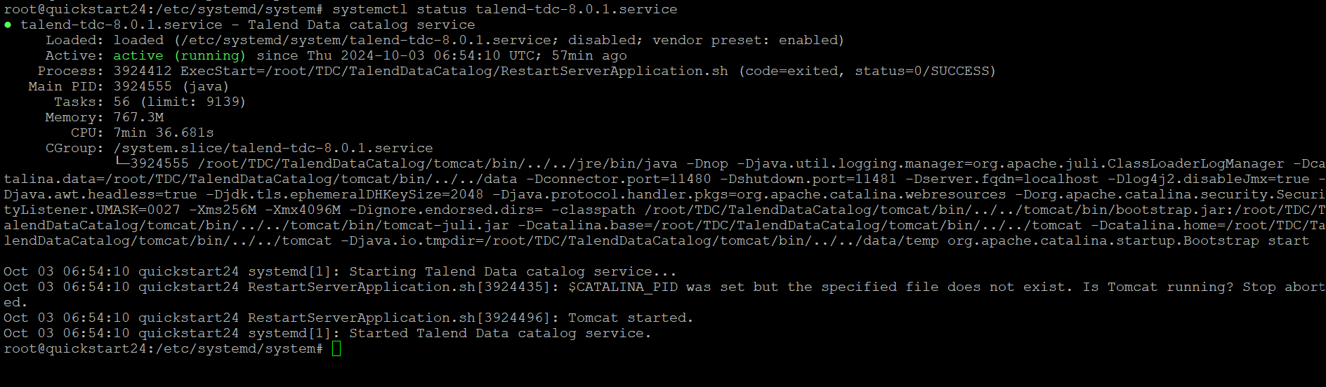
#Start and stop the services using below commands
1)systemctl start talend-tdc-8.0.1.service
2)systemctl stop talend-tdc-8.0.1.service
3)systemctl status talend-tdc-8.0.1.service

Slide 14
*Installing all the jar files when the Internet is unavailable on the Linux server*
# Install the TDC on the Linux machine which have complete internet access and download all the jar files by running the
MIMB.sh file and replace the MIMB folder from one Linux machine to another Linux machine which have no internet connectivity.
Downloading the drivers by using a command line | How to retrieve third-party drivers when the Talend Data Catalog server has no Internet connection Help (qlik.com)
https://help.qlik.com/talend/en-US/talend-data-catalog/8.1/Subsystems/DeploymentGuide/Content/Application-Server-Execution-and-Initialization.htm

Slide 15
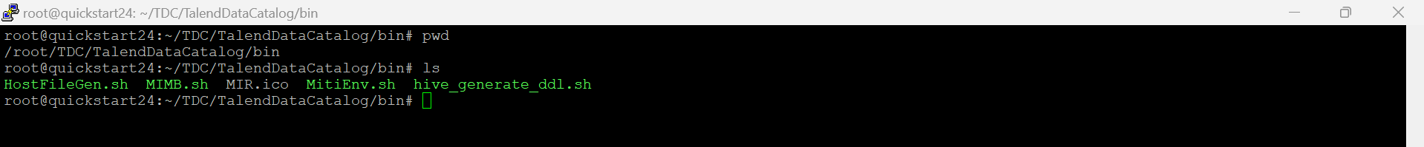
#Goto the Talend Data catalog installation directory.
#Goto MIMB.sh file for Linux and MIMB.bat file for Windows
#Run the MIMB.sh file
./MIMB.sh -d

Slide 16
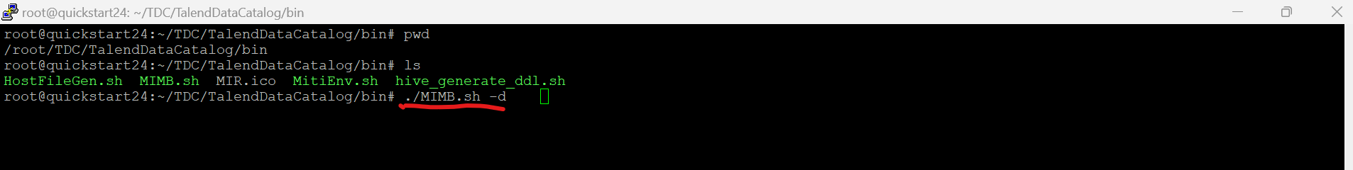
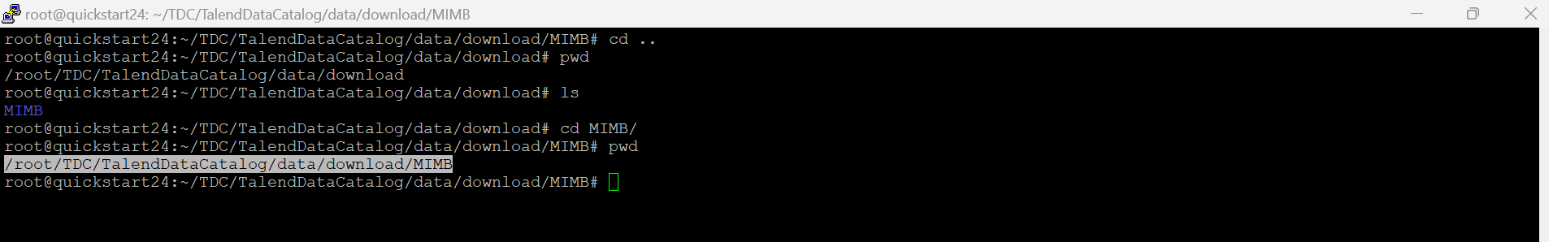
#Check all the jar files in MIMB directory
cd /root/TDC/TalendDataCatalog/data/download/MIMB
*Replace the complete MIMB folder from one server to another server.

